Slide 1

AML-2103 Visualization for AI and ML
Lambton College
School of Computer Studies
[Prepared By: Vahid Hadavi, PhD]

Slide 2
Lecture4
Major Topics:
4.1 Discuss basic pandas operations
4.2 Pandas CorssTab
4.3 Explain advantages and drawbacks of pandas over NumPy
4.4 Compute central tendency and dispersion using pandas
4.5 Apply Indexing, Slicing and Iterating using pandas
4.6 Demonstrate advanced pandas operations: Filtering, Sorting and Reshaping

Slide 3
4.1 Discuss basic pandas operations

Slide 4
Pandas basic operations
Many of such operations are covered in your advanced python course, we are going to review few different tasks here.
We need to import pandas.
We can load different types of files into a dataframe or series using pandas.
Alternatively you can create your own dataframe.
We are going to discuss crosstabs between two or multiple column here.
Crosstabs can be quite helpful in pre/post modeling analysis of your data

Slide 5
4.2 Discuss basic pandas operations (CorssTab)

Slide 6
Pandas Crosstabs
Introduction
Pandas offers several options for grouping and summarizing data but this variety of options can be a blessing and a curse.
These approaches are all powerful data analysis tools but it can be confusing to know whether to use a groupby , pivot_table or crosstab to build a summary table.
This section will discuss the pandas crosstab function, explain its usage and illustrate how it can be used to quickly summarize data.
The goal is to have this section as a resource that you can bookmark and refer to when you need to remind yourself what you can do with the crosstab function

Slide 7
Pandas Crosstabs
Overview
The pandas crosstab function builds a cross-tabulation table that can show the frequency with which certain groups of data appear. For a quick example, this table shows the number of two or four door cars manufactured by various car makers:
num_doors | four | two | Total
make
honda | 5 | 8 | 13
mazda | 7 | 9 | 16
mitsubishi | 4 | 9 | 13
nissan | 9 | 9 | 18
subaru | 9 | 3 | 12
toyota | 18 | 14 | 32
volkswagen | 8 | 4 | 12
volvo | 11 | 0 | 11
Total | 71 | 56 | 127
In the table above, you can see that the data set contains 32 Toyota cars of which 18 are four door and 14 are two door. This is a relatively simple table to interpret and illustrates why this approach can be a powerful way to summarize large data sets.
Pandas makes this process easy and allows us to customize the tables in several different manners. In the rest of the article, I will walk through how to create and customize these tables.

Slide 8
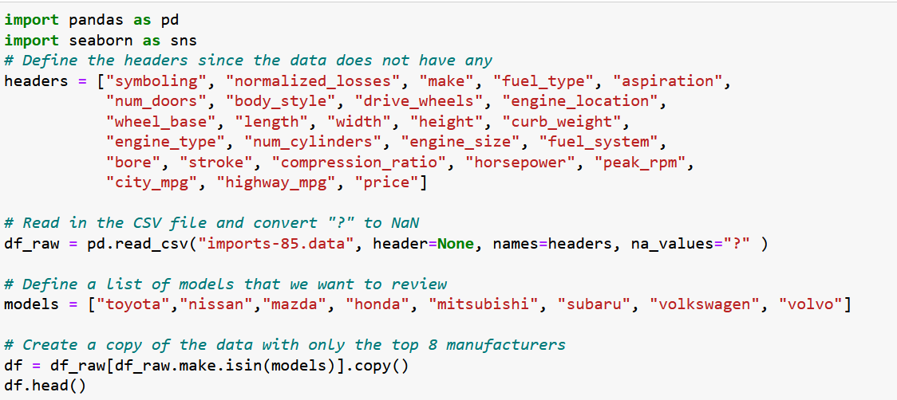
Pandas Crosstabs
Start the Process
Let’s get started by importing all the modules we need.
Now we’ll read in the automobile data from the UCI Machine Learning Repository and make some label changes for clarity (you can download the file from the Moodle):

Slide 9
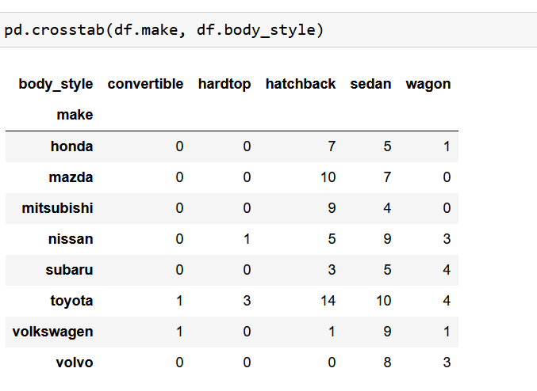
Pandas Crosstabs
For the first example, let’s use pd.crosstab to look at how many different body styles these car makers
The crosstab function can operate on numpy arrays, series or columns in a dataframe.
For this example, I pass in df.make for the crosstab index and df.body_style for the crosstab’s columns.
Pandas does that work behind the scenes to count how many occurrences there are of each combination.
For example, in this data set Volvo makes 8 sedans and 3 wagons.

Slide 10
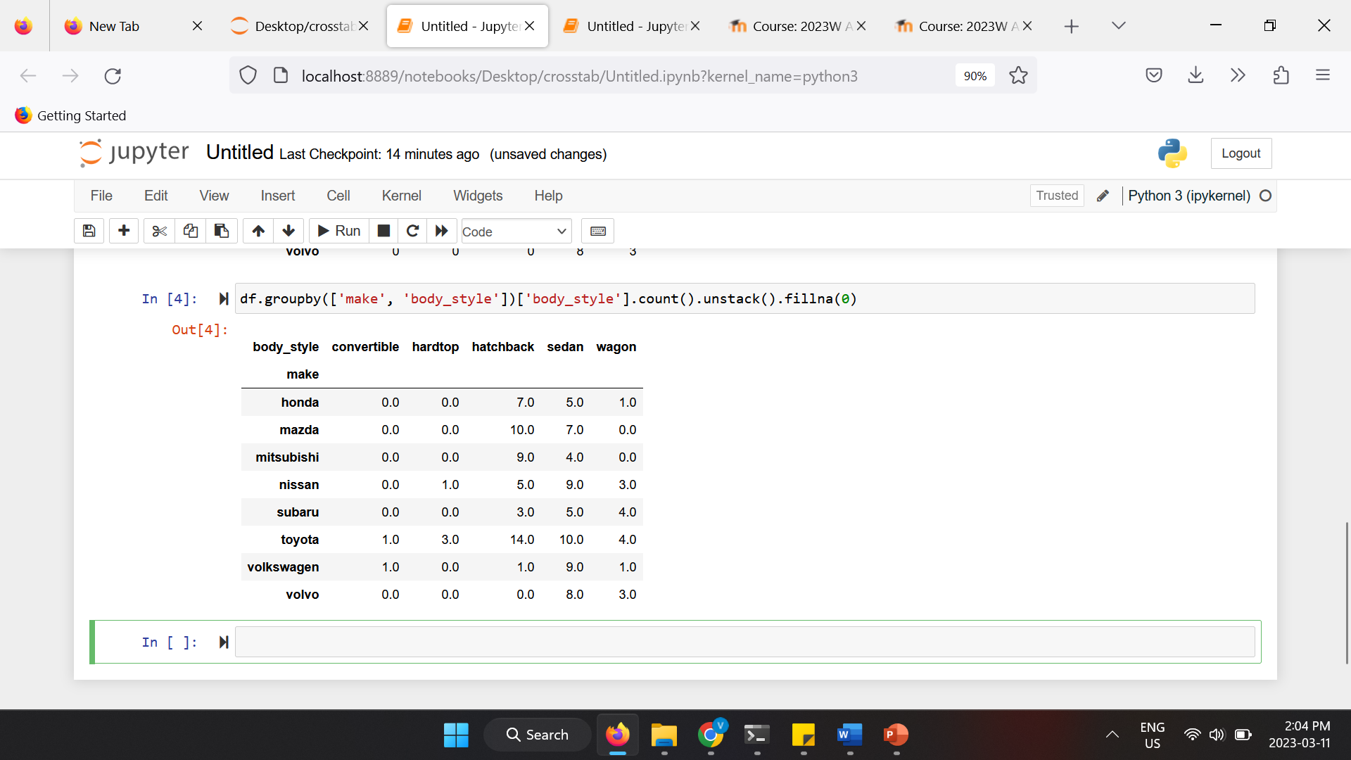
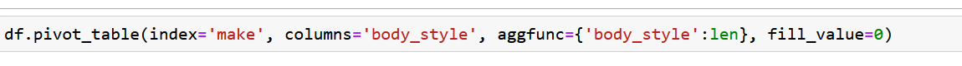
Pandas Crosstabs
Before we go much further with this example, more experienced readers may wonder why we use the crosstab instead of a another pandas option. I will address that briefly by showing two alternative approaches.
First, we could use a groupby followed by an unstack to get the same results:
It is also possible to do something similar using a pivot_table :

Slide 11
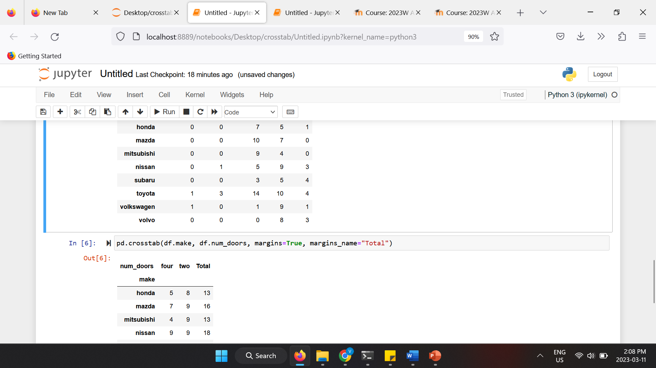
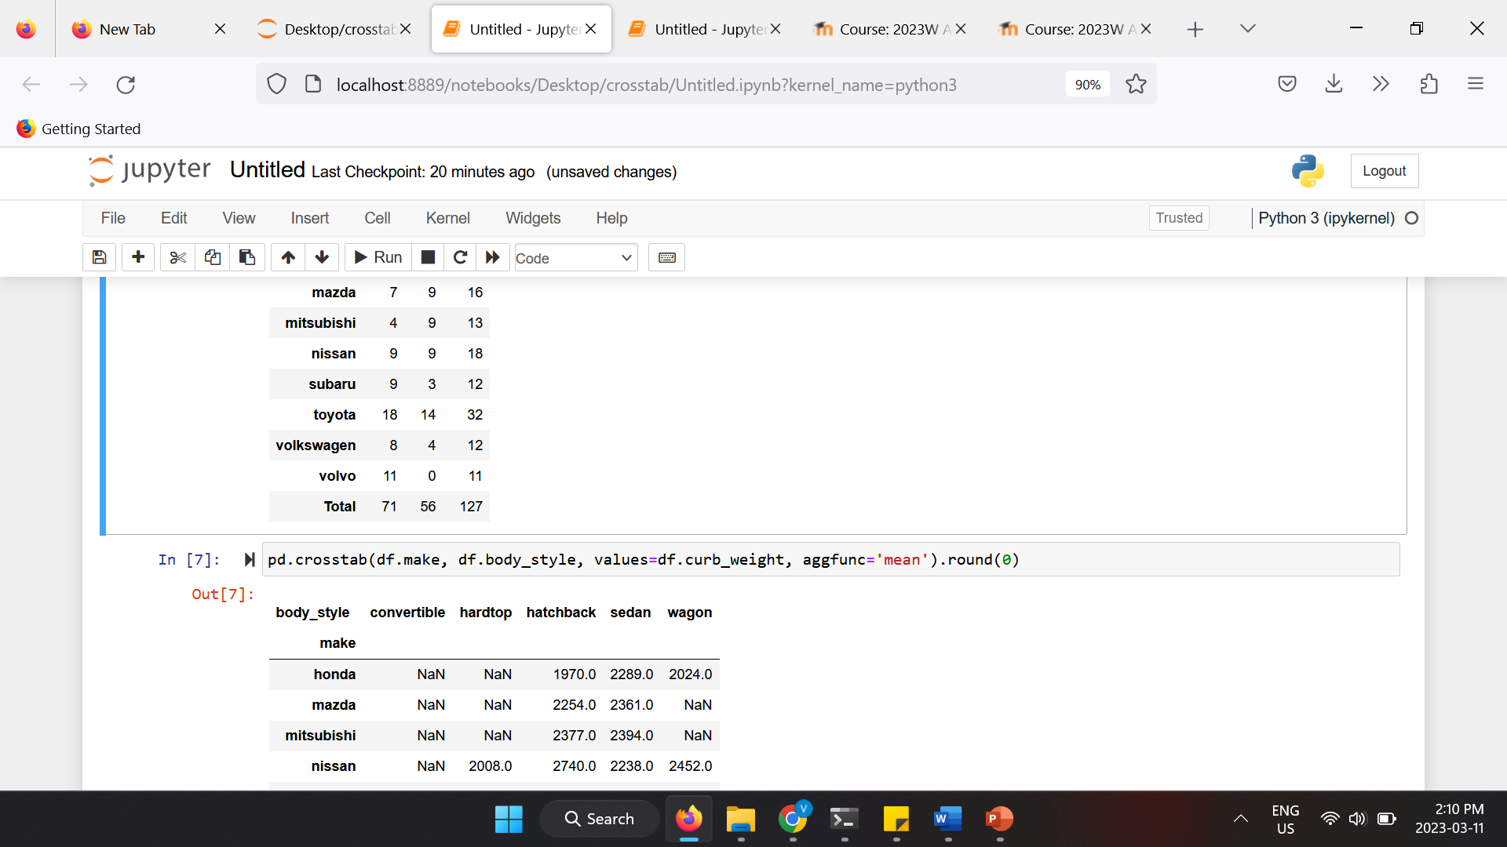
Pandas Crosstabs
Diving Deeper into the Crosstab
Now that we have walked through the basic crosstab process, I will explain some of the other useful changes you can make to the output by altering the parameters.
One common need in a crosstab is to include subtotals. We can add them using the margins keyword:
All of these examples have simply counted the individual occurrences of the data combinations. crosstab allows us to do even more summarization by including values to aggregate. To illustrate this, we can calculate the average curb weight of cars by body style and manufacturer:

Slide 12
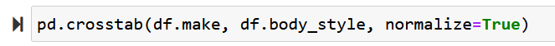
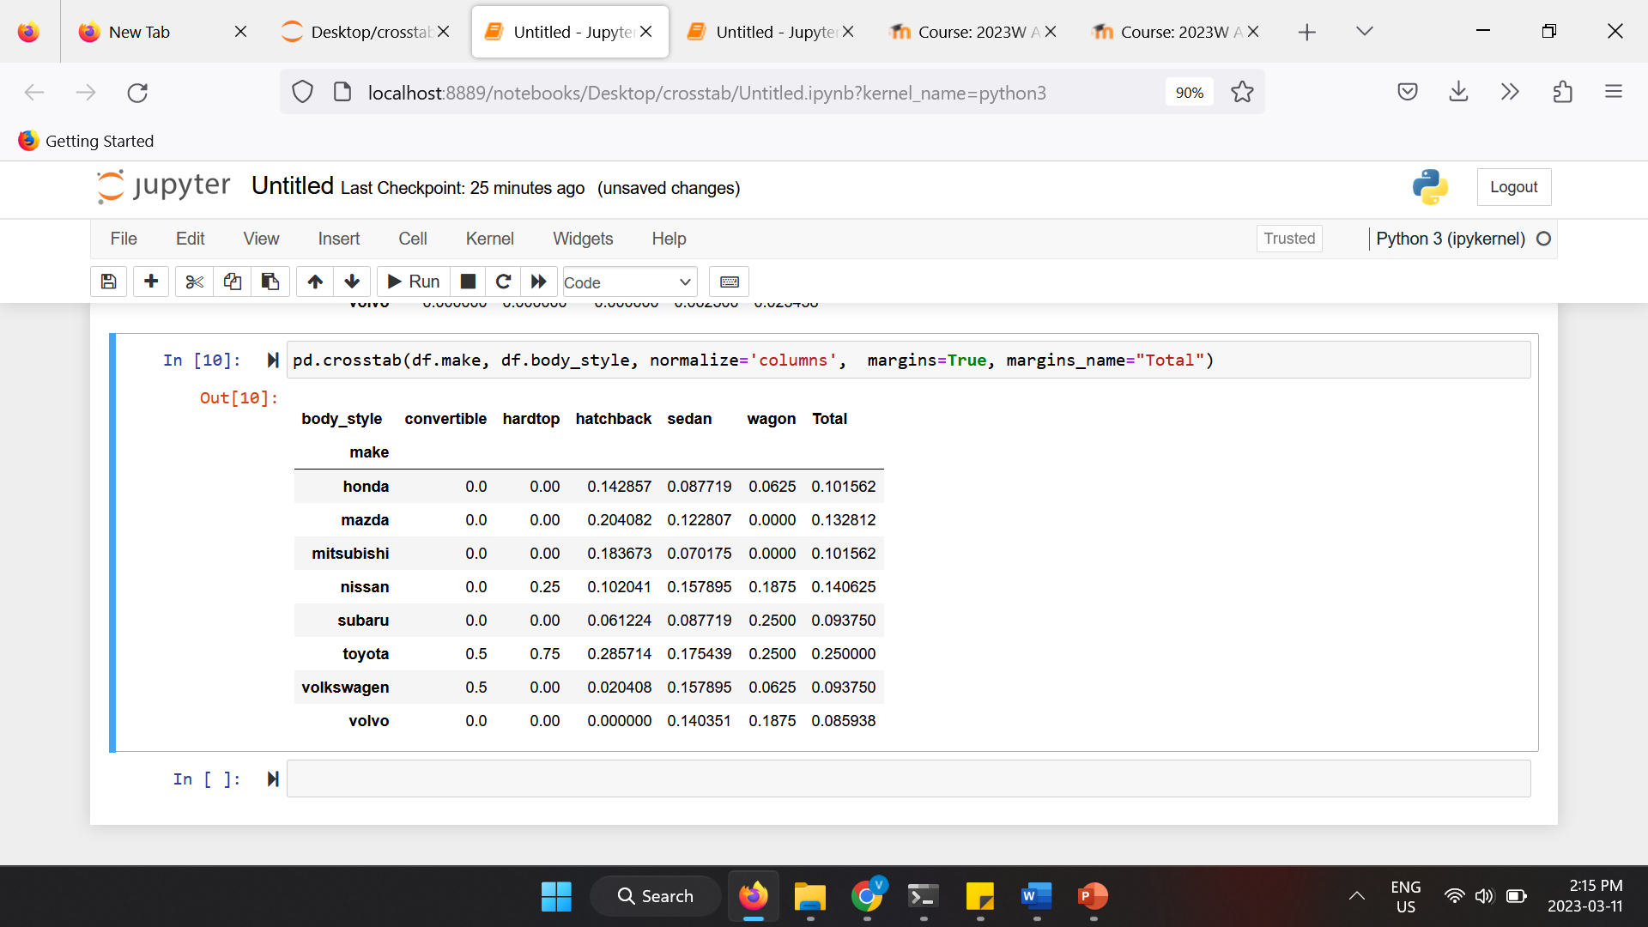
Pandas Crosstabs
We have seen how to count values and determine averages of values. However, there is another common case of data sumarization where we want to understand the percentage of time each combination occurs. This can be accomplished using the normalize parameter:
The normalize parameter is even smarter because it allows us to perform this summary on just the columns or rows. For example, if we want to see how the body styles are distributed across makes:

Slide 13
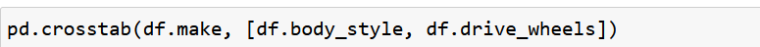
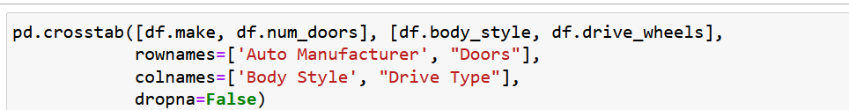
Pandas Crosstabs
Grouping
One of the most useful features of the crosstab is that you can pass in multiple dataframe columns and pandas does all the grouping for you. For instance, if we want to see how the data is distributed by front wheel drive (fwd) and rear wheel drive (rwd), we can include the drive_wheels column by including it in the list of valid columns in the second argument to the crosstab .
We can also do the same thing with the index:
We used dropna=False at the end of the function call. The reason I included this is that I wanted to make sure to include all the rows and columns even if they had all 0’s. If I did not include it, then the final Volvo, two door row would have been omitted from the table.

Slide 14
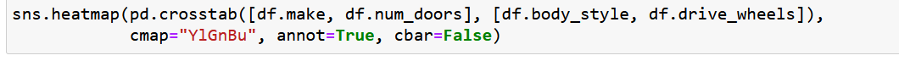
Pandas Crosstabs
Visualizing
For the final example, I will bring it all together by showing how the output of the crosstab can be passed to a seaborn heatmap in order to visually summarize the data.
In our last table, we ended up with a table of 240 values. This is too dense to quickly analyze but if we use a heatmap, we can easily interpret the data.
Fortunately, seaborn can take the output from the crosstab and visualize it.

Slide 15
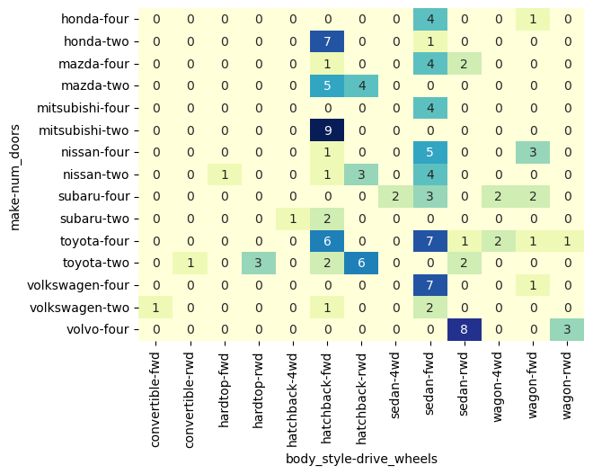
Pandas Crosstabs
This heatmap is the output of the code in the previous slide.
One of the really useful aspects of this approach is that seaborn collapses the grouped column and row names so that they can be more easily read.

Slide 16
4.3 Explain advantages and drawbacks of pandas over NumPy

Slide 17
Advantages and Disadvantages
Advantages
High level of abstraction
Less intuition
Faster processing
Easy DataFrames design
Disadvantages
Less applicable
More disk space
Performance problems
Hidden complexity

Slide 18
4.4 Compute central tendency and dispersion using pandas

Slide 19
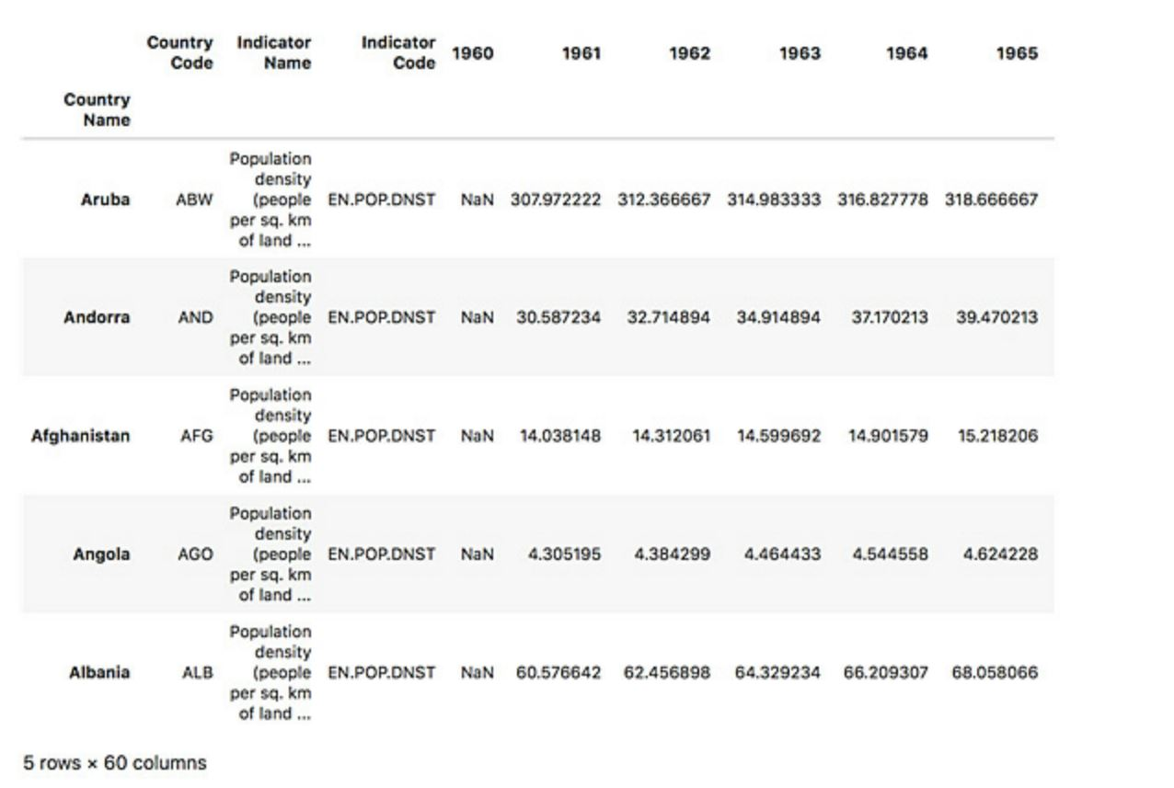
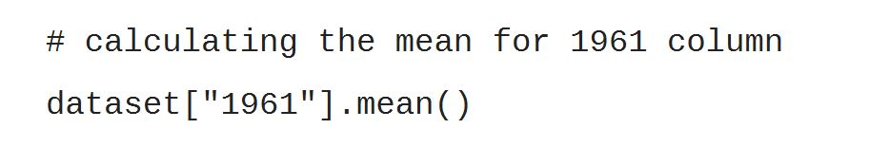
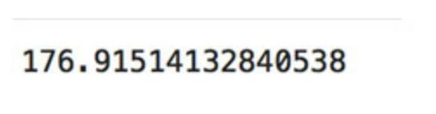
central tendency and dispersion

Slide 20
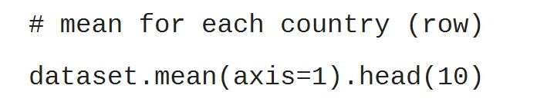
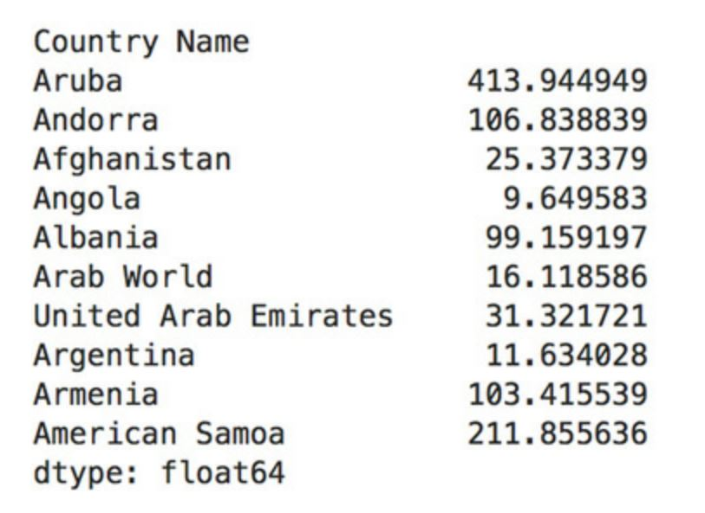
central tendency and dispersion
Using axis parameter we can have the values per columns (axis=0) and per rows (axis=1).
By default axis=0 is used.

Slide 21
4.5 Apply Indexing, Slicing and Iterating using pandas

Slide 22
Indexing
We can access columns with the single bracket.
We can access rows with index numbers, using iloc[]
We can access rows with index names, using loc[].

Slide 23
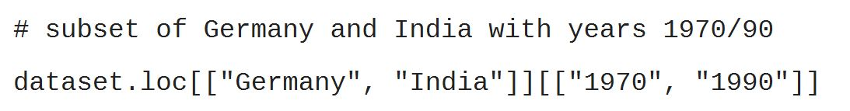
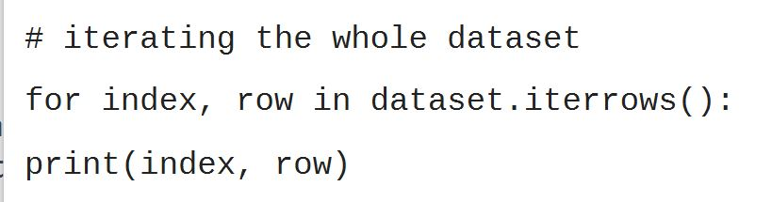
Slicing and Iterating
We can slice dataframes using loc[] and iloc[].
We can use iterrows() to iterate over rows and columns in pandas.

Slide 24
4.6 Demonstrate advanced pandas operations: Filtering, Sorting and Reshaping

Slide 25
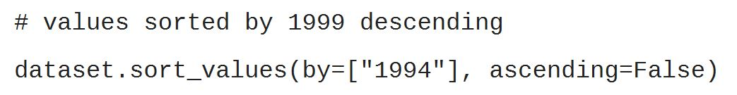
Filtering and Sorting
We can use the brackets-based conditional filtering.
We can sort a dataframe using sort_values().
We can use “by” parameter to specift the column or columns we want to sort based on.
We can sort in descending order by setting “ascending” on False.

Slide 26
Reshaping
We can use pivot() to reshape a dataframe.
Reshaping is a very complex topic. If you want to dive deeper into it, refer to pandas documentation.
https://pandas.pydata.org/pandas-docs/stable/reference/api/pandas.pivot_table.html

Slide 27
Any questions so far? Any comments?

